Slide 1
INNOVATIVE IDEA FOR NOISE POLLUTION MONITORING USING IOT
An innovative idea for noise pollution monitoring using IoT could involve deploying a network of smart, low-cost sensors that continuously collect and transmit data to a central database. Here are the key components of this concept

Slide 2
Noise Anomaly Detection: Develop algorithms that can detect noise anomalies or excessive noise events, which could trigger alerts or notifications to relevant authorities or residents.

Slide 3
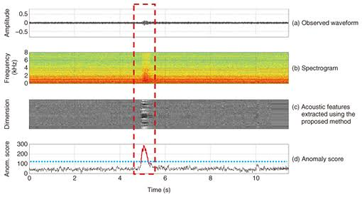

Slide 4
Policy Insights: Use the collected data to gain insights into noise pollution patterns and trends, helping urban planners and policymakers implement effective noise reduction strategies.

Slide 5
Smart Noise Sensors: Develop compact and cost-effective noise sensors equipped with microphones and IoT connectivity (e.g., Wi-Fi, LoRa, or NB-IoT). These sensors should be able to measure various noise parameters, such as decibel levels, frequency analysis, and temporal patterns.

Slide 6
Distributed Sensor Network: Install these sensors at strategic locations throughout urban areas, near highways, industrial zones, and residential neighborhoods to create a comprehensive monitoring network.

Slide 7
Real-Time Data Transmission: Enable real-time data transmission from the sensors to a central server or cloud platform. This data should include noise levels, GPS coordinates, and timestamps.

Slide 8
Data Analytics and Visualization: Implement data analytics algorithms to process the collected data. Visualize the information on interactive dashboards and maps, making it accessible to both city officials and the public.

Slide 9
CONCLUSION : This IoT-based noise pollution monitoring system would provide valuable data for improving the quality of life in urban areas and support evidence-based decision-making for noise reduction and urban planning.

Slide 10
PROGRAM FOR NOISE POLLUTION MONITORING
import os
import alsaaudio
import numpy as np
import time

Slide 11
#Set up the audio input
inp = alsaaudio.PCM(alsaaudio.PCM_CAPTURE)
#Define audio parameters
inp.setchannels(1)
inp.setrate(44100)
Inp.setformat(alsaaudio.PCM_FORMAT_S16_LE)

Slide 12
#Set up the noise threshold (adjust as needed)
Noise_treshold = 50
While True:
#Read audio data_,data = inp.read()
#Convert the data to a numpy array
audio_dara = np.frombuffer(data,dtype=‘int16’)
#Calculate the root mean square (RMS) of the audio data
rms=np.sqrt(np.mean(audio_data**2))

Slide 13
#Print the current noise level
Print(f’Noise level (dB):{20*np.log10(RMS)}’)
#Check if the noise level exceeds the threshold
If 20*np.log10(RMS)>noise_threshold:

Slide 14
#Implement actions for when noise exceeds the threshold
Print(“Noise threshold exceeded!”)
#Wait for a short interval(adjust as needed)
Time.sleep(1)

